Slide 1
Screen Test Pattern (4:3)
Aspect Ratio Test
(Should appear circular)
4x3

Slide 2
Presentation on
Asynchronous JavaScript Promises And AJAX

Slide 3
Contents
1 | Synchronous and Asynchronous
2 | Ajax and Ajax Calls
3 | API and API Data Formats
4 | Promise Introduction
5 | Promise Life Cycle
6 | Promise Life Cycle Example
7 | Consuming Promise

Slide 4
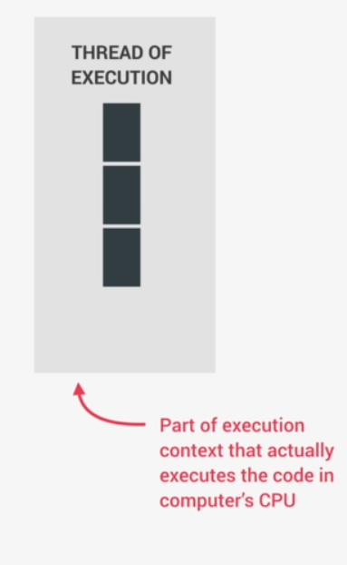
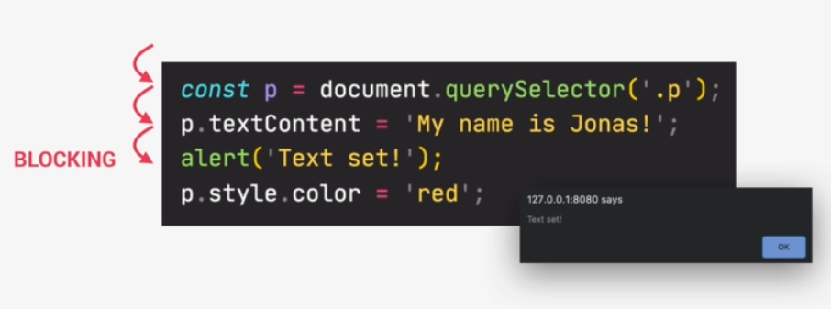
Synchronous :
Most Code is Synchronous .
Synchronous Code is executed line by line
Each Line of code waits for previous line to finish
Long Running Operation Block code Execution

Slide 5
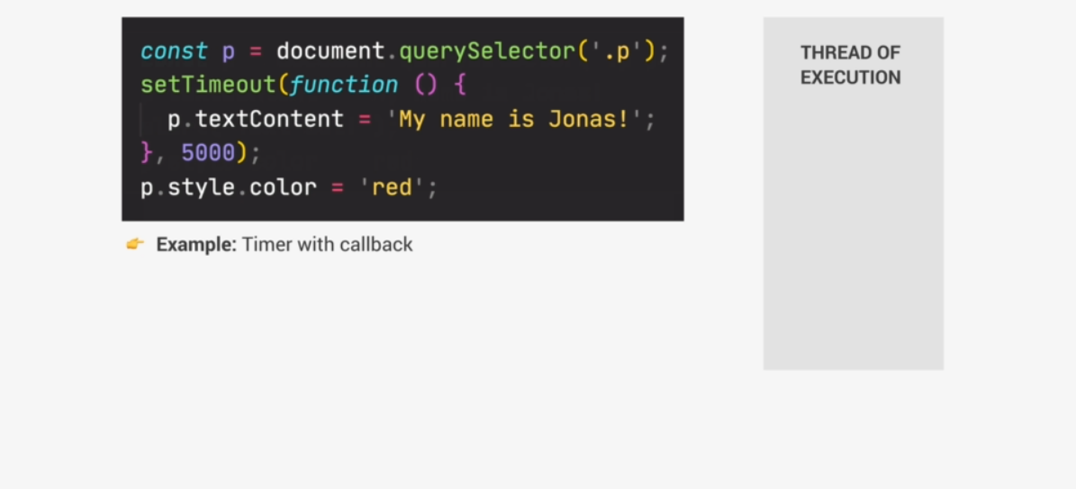
Is It Synchronous or Not ?

Slide 6
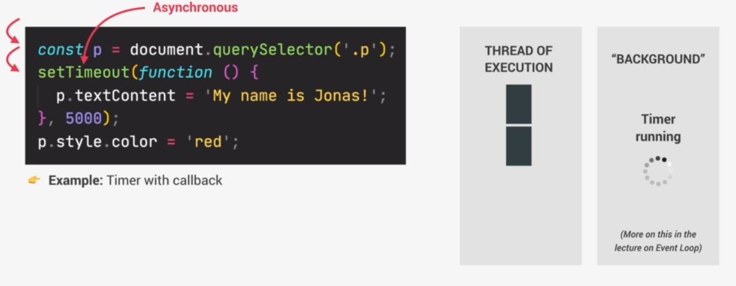
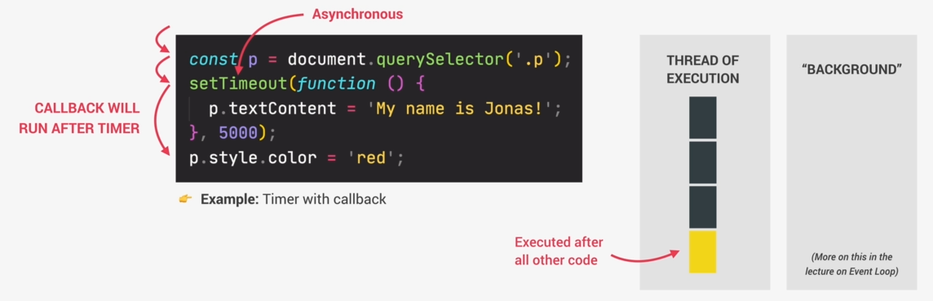
ASynchronous :
Asynchronous Code Is Executed after a task that runs in the “background” finishes .
Asynchronous code is non blocking .
Execution doesn’t wait for an asynchronous task to finish its work.
Call Back functions alone do not make code Asynchronous.
Coordinating behavior of a program over a period of time.

Slide 7
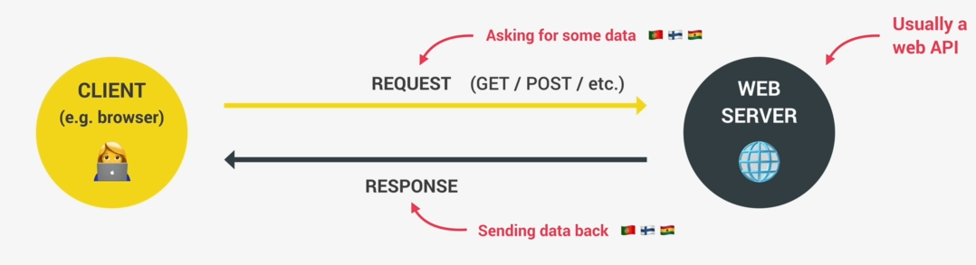
Ajax and Ajax Calls :
Ajax (Asynchronous Javascript And Xml) Allow us to communicate with remote web servers in an asynchronous way .with Ajax calls, we can request data from web servers dynamically .

Slide 8
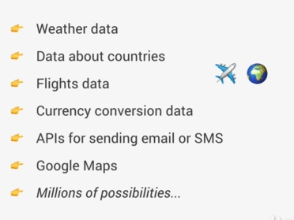
What is API :
Application Programming Interface: Piece of software that can be used by another piece of software ,in order to allow applications to talk with each other.
Online API When We Use Ajax : Application Running on a server ,that receives request for data and sends data back as response.
We can build our own web APIs (requires backend development development e.g Node.js ) or use 3rd Party APIs .
In Above Example, The travel Application when use as an API you can :

Slide 9
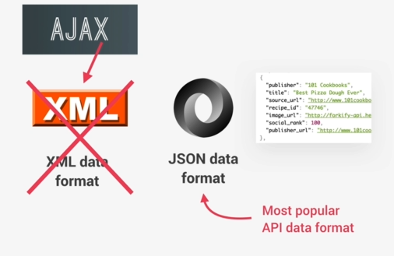
API Data Formats :
Ajax Stands For Asynchronous Javascript and XML so the X here stands for XML and XML is a data format which used to be widely used to transmit data on the web.
Basically No API uses XML data anymore the Term Ajax is just an old Name that got very popular back in the day and so its still used today even though we don’t use XML anymore .
So Instead ,Most API these days use the JSON data Format so JSON is the most Popular data format Today. Because it’s basically just a Javascript notation but converted to string.so therefore its very easy to send across the web and also to use in Javascript once the data arrives.

Slide 10
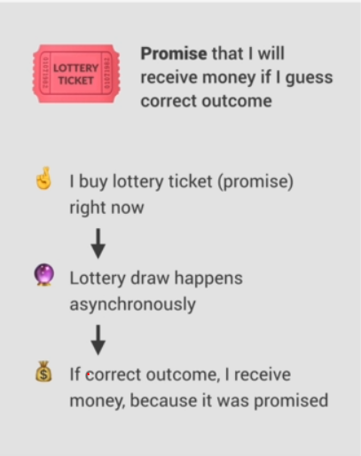
What are Promise :
An Object that is used as a placeholder for the future result of an asynchronous operation .
A container for an asynchronous delivered value.
A container for a future value example : Response from Ajax Call.
We no longer need to rely on events and callbacks passed into asynchronous functions to handle asynchronous results.
Instead of nesting callbacks ,we can chain promise for a sequence of asynchronous operations : escaping call back hell

Slide 11
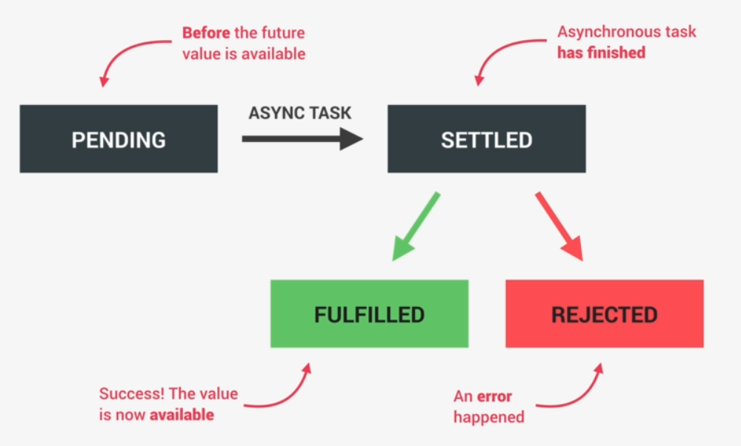
Promise LifeCycle :
Pending Promise : Before the Future Value is Available .
Settled Promise : Asynchronous task has finished.
There are two different types of Settled Promises that are fulfilled promises and rejected promises.
Fulfilled Promise : A fullfilled promise is a promise that has successfully resulted in a value just as we expected.example when we use the promise to fetch data from an API a fullfilled promise successfully guts that data and its now available to being used .
Rejected Promise : A rejected means that there has been an error during the asynchronous task. The Example of fetching data from an API an error would be for example when the user is offline and can’t Connect to the API server .

Slide 12
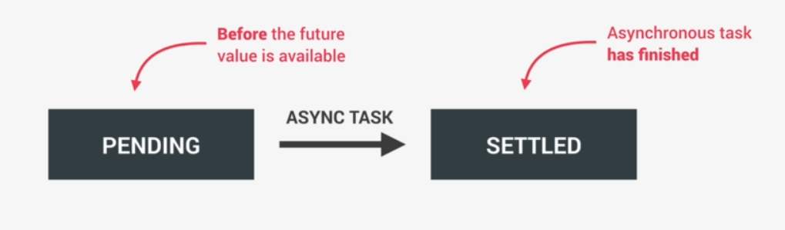
Promise LifeCycle :
Pending Promise : In the very beginning,we say that the promise is pending and so this is before any value resulting from the asynchronous task is available .
Settled Promise : During the pending promise time, the asynchronous task is still doing its work in the background. when the task finally finishes we say that the promise is settled .

Slide 13

Promise LifeCycle Continue :
There are two different types of Settled Promises that are fulfilled promises and rejected promises.
Fulfilled Promise : A fulfilled promise is a promise that has successfully resulted in a value just as we expected .For Example : when we use the promise to fetch data from an API a fulfilled promise successfully guts that data and its now available to being used .
Rejected Promise : A rejected means that there has been an error during the asynchronous task. The Example of fetching data from an API an error would be for example when the user is offline and can’t Connect to the API server .

Slide 14
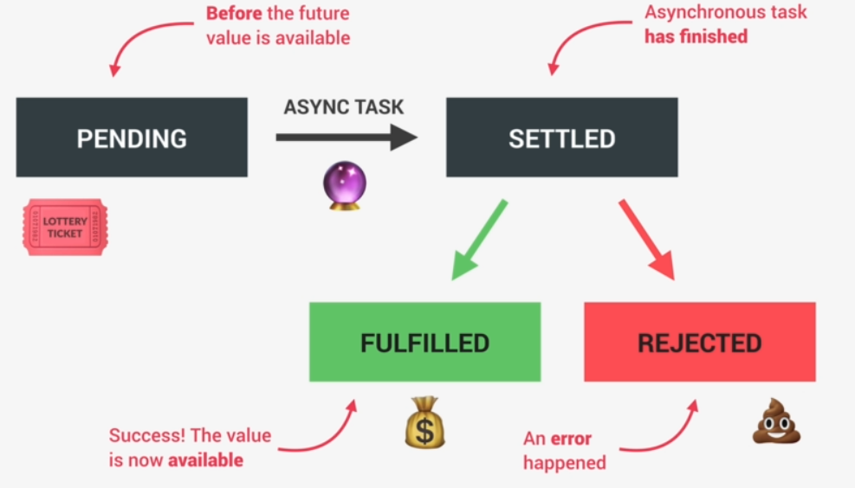
Promise LifeCycle In A Example :
Now Going back to the analogy of our lottery ticket ,,the lottery draw is basically the asynchronous task . which determines the results then once the result is available. The ticket would be settled then if we guessed the correct outcome the lottery ticket will be fulfilled and we get our money However if we guessed wrong then the ticket basically gets rejected and all we did was waste our money.
Now these different states are very important to understand because when we use promises in our code.we will be able to handle these different states in order to do something as a result of either a successful promise or rejected one.
A promise is only settled once and so from there the sate will remain unchanged forever.so the promise was either fulfilled or rejected but it’s impossible to change that state.

Slide 15
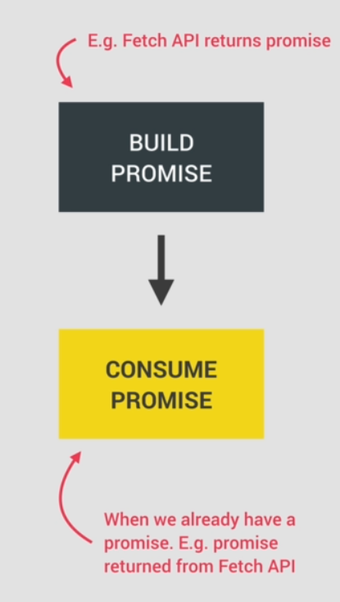
Consuming Promise :
Now Since the different states that we did the promise life cycle are relevant and useful when we use a promise to get a result which is called , to consume a promise.
so we consume a promise when we already have a promise , for example the promise that was returned from the fetch function right at the beginning in the promise introduction code
In order for a promise to exist in the first place , it must first be build.so it must be first created in the case of fetch API , it’s the fetch function that build the promise and returns it for us to consume.so in this case we don’t have to build the promise ourselves in order to consume it.

